Slide 1
Subsidy Chain: Promising Transparency and Integrity in Government Fund Distribution
PIP2001 Capstone Project
VIVA-VOCE
BATCH NUMBER: CBC-09
Under the Supervision of
Ms.Arshiya Lubna
Assistant Professor
School of Computer Science & Engineering
Presidency University
ROLL NUMBER | STUDENT NAME
20211CBC0039 | Y Harshitha Reddy
20211CBC0046 | Dyamalli K
20211CBC0049 | Monica N
20211CBC0061 | Rupalagudi Likhitha
Name of the Program: CSE(Blockchain)
Name of the HoD: Dr.Pravintha Raja
Name of the Program Project Coordinator: Ms. Suma NG
Name of the School Project Coordinators: Dr. Sampath A K / Dr. AbdulKhadar A / Mr. Md Ziaur Rahman

Slide 2
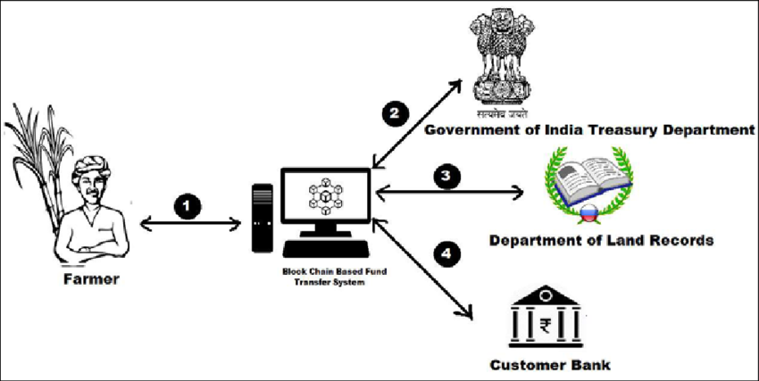
Introduction
Subsidy Chain leverages blockchain technology, using the Polygon network and Solidity smart contracts, to create a transparent, immutable tracking system for government subsidies. This DApp ensures that every step of subsidy distribution is recorded and accessible.
By automating verification processes, Subsidy Chain minimizes human error and fraud. Beneficiaries can track their subsidies, ensuring funds reach them as intended, thus enhancing trust and integrity in the system.

Slide 3
Literature Review
S. No. | Title | Author(s) | Year | Inference
1. | Blockchain's Architectural Framework and Applications. | Zheng et al | 2018 | Blockchain’s decentralization and immutability create trust, addressing inefficiencies and corruption in traditional subsidy distribution systems.
2. | Blockchain Implementation in Public Sector Services. | Alharbi et al | 2020 | Blockchain improves transparency, reduces fraud, and enhances accountability in public services through real-time tracking of funds.

Slide 4
S.NO | Title | Author(s) | Year | Inference
3. | Blockchain’s Role in Public Finance Transparency. | Kshetri | 2017 | Blockchain helps mitigate corruption in subsidy programs, especially in programs targeting low-income households, by improving transparency.
4. | Financial Flow Transparency with Blockchain. | Treleaven et al. | 2017 | Blockchain's ability to trace financial flows enhances accountability and transparency, deterring fraud in subsidy distribution.
5. | Blockchain in Agricultural Finance: A Case Study. | Omar et al. | 2021 | Smart contracts automate subsidy disbursement, ensuring funds are used as intended, thus increasing subsidy program efficacy.

Slide 5
S. No. | Title | Author(s) | Year | Inference
6. | Empirical Analysis of Blockchain’s Impact on Public Finance. | Hassan & Kyriakou | 2020 | Blockchain reduces transaction costs and enhances fund distribution efficiency, making it particularly useful for managing subsidies.
7. | Designing DApps for Transparency in the Public Sector. | Alvarez & K. T. | 2021 | Successful blockchain integration in public finance requires careful planning, addressing technological, organizational, and regulatory challenges.
8. | Legal and Regulatory Challenges in Blockchain Integration. | Cai & Zhu | 2020 | A supportive legal framework is essential for the successful implementation of blockchain applications in public finance.

Slide 6
S. No. | Title | Author(s) | Year | Inference
9. | Blockchain in Social Welfare Programs. | Kumar et al. | 2022 | Blockchain DApps empower beneficiaries by providing transparency in subsidy distribution, reducing fraud, and fostering trust among citizens.
10. | Blockchain for Government Fund Transparency: A Critical Assessment. | Zhao et al. | 2023 | Blockchain can revolutionize government fund management by enhancing transparency and integrity in subsidy distribution systems.

Slide 7
Research Gaps Identified
The current methods of government subsidy distribution predominantly rely on traditional approaches
Centralized Databases
Manual Processing
Lack of Traceability
Limited Beneficiary Engagement
Inflexibility to Adapt
High Administrative Costs

Slide 8
Proposed Methodology
1. System Architecture
Components:
Government Agencies: Initiate and record disbursements.
Smart Contracts: Automate rules on the Polygon blockchain.
Beneficiaries: Users tracking fund status via DApp.
2. Workflow
Phase 1: Agencies create subsidy programs; beneficiaries apply with verified credentials.
Phase 2: Approved programs deploy smart contracts with eligibility criteria.
Phase 3: Funds are released to verified beneficiaries' wallets after eligibility checks.
Phase 4: Beneficiaries monitor real-time subsidy status, enhancing transparency.

Slide 9
Proposed Methodology
Key Features
Automation: Smart contracts handle fund release based on predefined conditions, reducing manual intervention.
Transparency: All transactions are recorded on the blockchain, ensuring public verifiability and accountability.
Real-Time Monitoring: Dashboards track programs, and beneficiaries receive instant notifications about their applications.
Security: Uses encryption for transaction security while maintaining privacy for sensitive data.

Slide 10
Objectives
Enhance Transparency
Ensure Accountability
Empower Beneficiaries
Streamline Fund Disbursement
Facilitate Data Integrity
Promote Public Trust
Enhance Collaboration

Slide 11
Methodology/Modules
The Subsidy Chain project includes key modules to ensure secure and transparent subsidy distribution:
1.Government Registration: Allows government agencies to register subsidy programs and store them on the blockchain for transparency.
2.Beneficiary Registration: Verifies and registers eligible beneficiaries using government databases, securing their data on the blockchain.
3.Smart Contract Management: Automates subsidy distribution with predefined rules, reducing delays and corruption.
4. Subsidy Disbursement: Transfers funds securely through the blockchain, making all transactions traceable.
5. Fund Tracking: Beneficiaries can track the status of their subsidies in real-time.
6. Data Integrity: Keeps data secure and tamper-proof using blockchain encryption.
7. Corruption Detection: Monitors for suspicious activities and reports issues to prevent fraud.

Slide 12
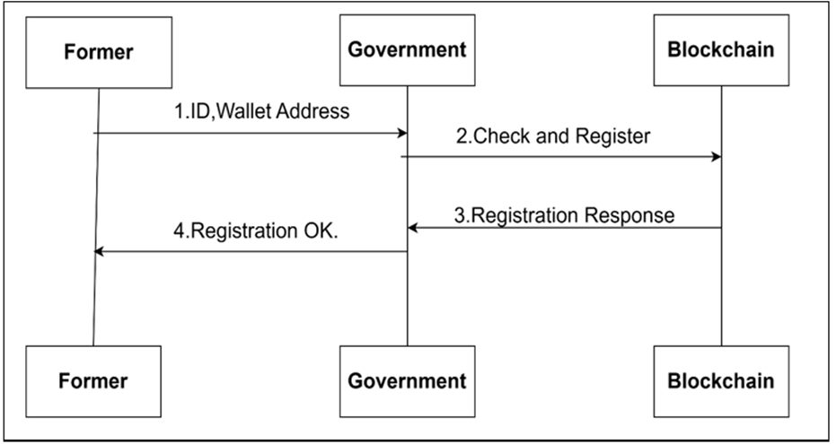
Entities and Their Roles:
Farmer: Submits subsidy applications and tracks claim status.
Government: Verifies eligibility, approves, and disburses subsidies.
Blockchain: Records transactions securely and automates the process through smart contracts.

Slide 13
Interaction Flow
Farmer → Government: Farmers submit applications with eligibility and identity details.
Government → Blockchain: Government verifies and approves, triggering subsidy disbursement via smart contracts.
Blockchain → Farmer: Farmers receive confirmation and can verify transactions on the blockchain.
Farmer → Blockchain: Farmers check transaction details and report issues if needed.
Government → Blockchain: Government audits blockchain records for transparency and accuracy.

Slide 14
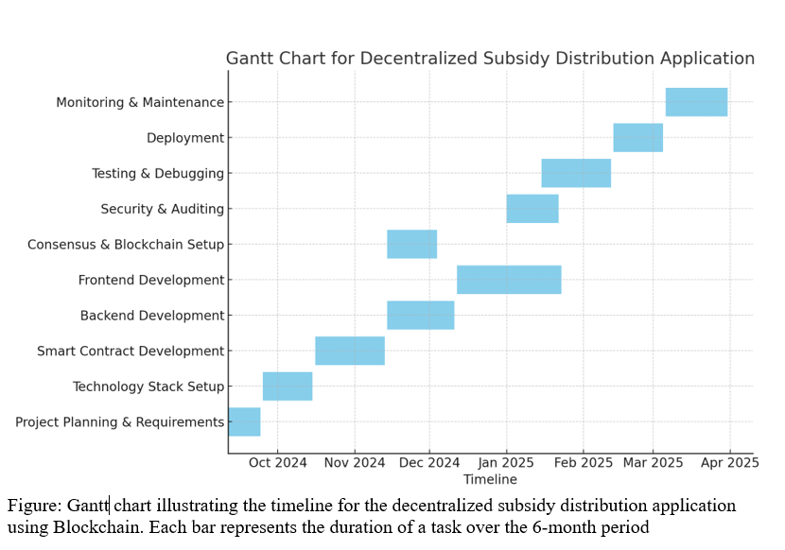
Timeline of Project

Slide 15
Outcomes/Results Obtained
More Transparency
Better Accountability
Easier Access for Beneficiaries
Less Fraud:
Real-time Monitoring
Secure Data

Slide 16
Conclusion
The Subsidy Chain project uses blockchain to create a transparent, secure, and efficient subsidy distribution system.
By automating processes through smart contracts, it eliminates corruption, minimizes delays, and ensures timely delivery of funds to beneficiaries.
The platform allows real-time tracking of payments, enhances accountability, and fosters trust in the government’s subsidy programs, ultimately leading to a more fair and efficient distribution process for all parties involved.

Slide 17
References
Z. Zheng et al., "Blockchain Technology: Applications and Use Cases," Journal of Industrial Information Integration, vol. 10, pp. 22-28, 2018.
M. A. Alharbi et al., "Blockchain in Public Sector Services: An Empirical Analysis," International Journal of Information Management, vol. 52, pp. 102-113, 2020.
N. Kshetri, "Can Blockchain Strengthen the Global Economy?" Journal of Business Research, vol. 70, pp. 228-234, 2017.
P. Treleaven et al., "Blockchain Technology in Finance: A New Paradigm," Computer and Telecommunications Law Review, vol. 23, no. 4, pp. 120-126, 2017.
A. Omar et al., "Smart Contracts for Subsidy Distribution: A Case Study in Agricultural Finance," Sustainability, vol. 13, no. 8, pp. 4230, 2021.

Slide 18
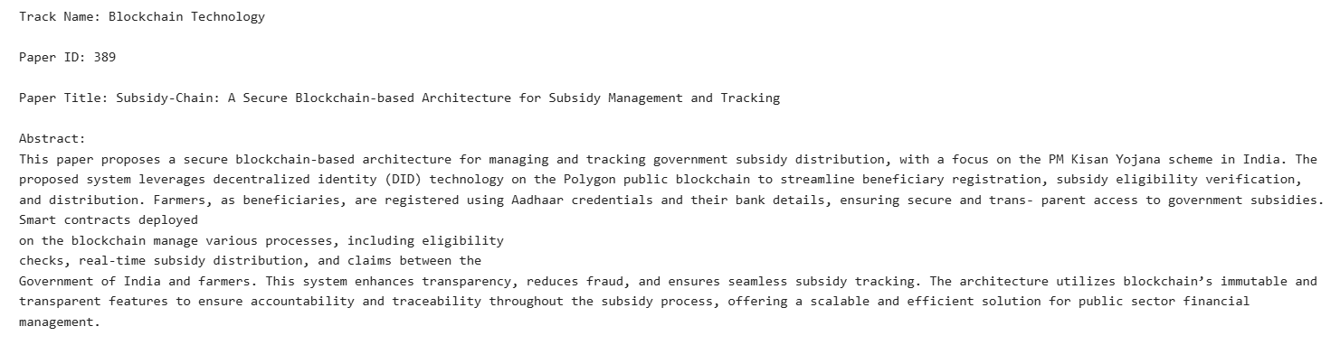
Publication Details

Slide 19
Thank You

